Slide 1



Slide 2

Introduce concepts such as dimension and basis
Introduce coordinate systems for representing vectors spaces and frames for representing affine spaces
Discuss change of frames and bases
Introduce homogeneous coordinates

Slide 3

A set of vectors v₁, v₂, …, v_{n} is linearly independent if
α₁v₁+α₂v₂+.. α_{n}v_{n}=0 iff α₁=α₂=…=0
If a set of vectors is linearly independent, we cannot represent one in terms of the others
If a set of vectors is linearly dependent, as least one can be written in terms of the others

Slide 4

In a vector space, the maximum number of linearly independent vectors is fixed and is called the dimension of the space
In an n-dimensional space, any set of n linearly independent vectors form a basis for the space
Given a basis v₁, v₂,…., v_{n}, any vector v can be written as
v=α₁v₁+ α₂v₂ +….+α_{n}v_{n}
where the {α_{i}} are unique

Slide 5

Until now we have been able to work with geometric entities without using any frame of reference, such as a coordinate system
Need a frame of reference to relate points and objects to our physical world.
  For example, where is a point? Can’t answer without a reference system
  World coordinates
  Camera coordinates

Slide 6

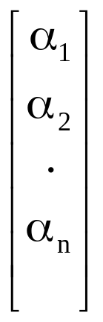
Consider a basis v₁, v₂,…., v_{n}
A vector is written v=α₁v₁+ α₂v₂ +….+α_{n}v_{n}
The list of scalars {α₁, α₂, …. α_{n}}is the representation of v with respect to the given basis
We can write the representation as a row or column array of scalars
a=[α₁ α₂ …. α_{n}]^{T}=

Slide 7

v=2v₁+3v₂-4v₃
a=[2 3 –4]^{T}
Note that this representation is with respect to a particular basis
For example, in OpenGL we start by representing vectors using the object basis but later the system needs a representation in terms of the camera or eye basis

Slide 8
Which is correct?
Both are because vectors have no fixed location
v
v

Slide 9

A coordinate system is insufficient to represent points
If we work in an affine space we can add a single point, the origin, to the basis vectors to form a frame
v₂
v₁
P₀
v₃

Slide 10

Frame determined by (P₀, v₁, v₂, v₃)
Within this frame, every vector can be written as
v=α₁v₁+ α₂v₂ +….+α_{n}v_{n}
Every point can be written as
P = P₀ + β₁v₁+ β₂v₂ +….+β_{n}v_{n}

Slide 11

Consider the point and the vector
P = P₀ + β₁v₁+ β₂v₂ +….+β_{n}v_{n}
v=α₁v₁+ α₂v₂ +….+α_{n}v_{n}
They appear to have the similar representations
p=[β₁ β₂ β₃] v=[α₁ α₂ α₃]
which confuses the point with the vector
A vector has no position
v
p
v
Vector can be placed anywhere
point: fixed

Slide 12

If we define 0•P = 0 and 1•P =P then we can write
v=α₁v₁+ α₂v₂ +α₃v₃ = [α₁ α₂ α₃ 0 ] [v₁ v₂ v₃ P₀] ^{T}
P = P₀ + β₁v₁+ β₂v₂ +β₃v₃= [β₁ β₂ β₃ 1 ] [v₁ v₂ v₃ P₀] ^{T}
Thus we obtain the four-dimensional homogeneous coordinate representation
v = [α₁ α₂ α₃ 0 ] ^{T}
p = [β₁ β₂ β₃ 1 ] ^{T}

Slide 13

The homogeneous coordinates form for a three dimensional point [x y z] is given as
p =[x’ y’ z’ w] ^{T} =[wx wy wz w] ^{T}
We return to a three dimensional point (for w≠0) by
x←x’/w
y←y’/w
z←z’/w
If w=0, the representation is that of a vector
Note that homogeneous coordinates replaces points in three dimensions by lines through the origin in four dimensions
For w=1, the representation of a point is [x y z 1]

Slide 14
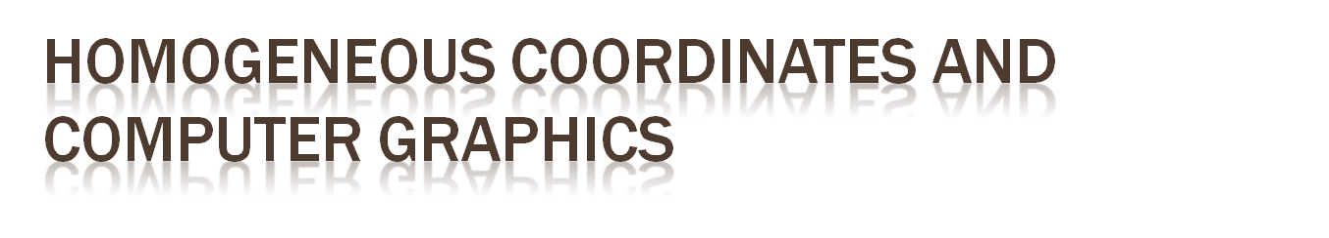
Homogeneous coordinates are key to all computer graphics systems
  All standard transformations (rotation, translation, scaling) can be implemented with matrix multiplications using 4 x 4 matrices
  Hardware pipeline works with 4 dimensional representations
  For orthographic viewing, we can maintain w=0 for vectors and w=1 for points
  For perspective we need a perspective division

Slide 15

Consider two representations of a the same vector with respect to two different bases. The representations are
a=[α₁ α₂ α₃ ]
b=[β₁ β₂ β₃]
where
v=α₁v₁+ α₂v₂ +α₃v₃ = [α₁ α₂ α₃] [v₁ v₂ v₃] ^{T}
=β₁u₁+ β₂u₂ +β₃u₃ = [β₁ β₂ β₃] [u₁ u₂ u₃] ^{T}

Slide 16

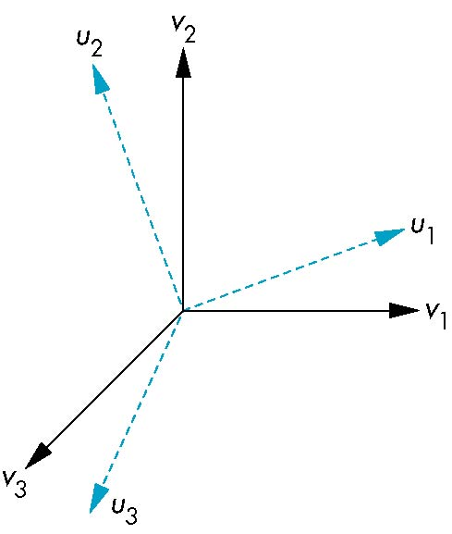
Each of the basis vectors, u1,u2, u3, are vectors that can be represented in terms of the first basis
v
u₁ = γ₁₁v₁+γ₁₂v₂+γ₁₃v₃
u₂ = γ₂₁v₁+γ₂₂v₂+γ₂₃v₃
u₃ = γ₃₁v₁+γ₃₂v₂+γ₃₃v₃

Slide 17

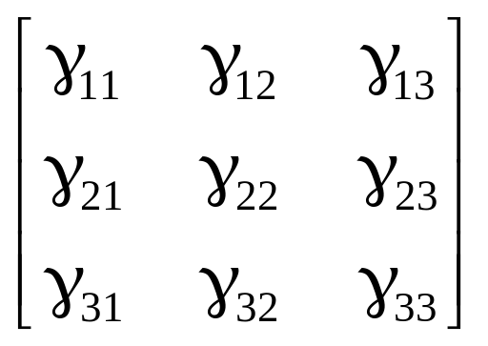
The coefficients define a 3 x 3 matrix
and the bases can be related by
see text for numerical examples
M =
a=M^{T}b

Slide 18

We can apply a similar process in homogeneous coordinates to the representations of both points and vectors
Any point or vector can be represented in either frame
We can represent Q₀, u₁, u₂, u₃ in terms of P₀, v₁, v₂, v₃
u₂
u₁
v₂
Consider two frames:
(P₀, v₁, v₂, v₃)
(Q₀, u₁, u₂, u₃)
Q₀
P₀
v₁
u₃
v₃

Slide 19

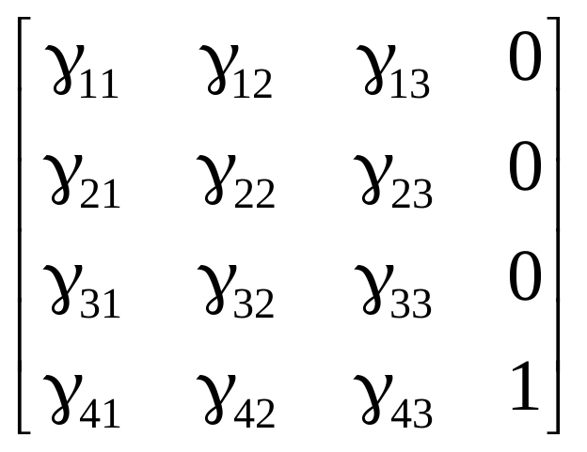
u₁ = γ₁₁v₁+γ₁₂v₂+γ₁₃v₃
u₂ = γ₂₁v₁+γ₂₂v₂+γ₂₃v₃
u₃ = γ₃₁v₁+γ₃₂v₂+γ₃₃v₃
Q₀ = γ₄₁v₁+γ₄₂v₂+γ₄₃v₃ +γ₄₄P₀
Extending what we did with change of bases
defining a 4 x 4 matrix
M =

Slide 20

Within the two frames any point or vector has a representation of the same form
a=[α₁ α₂ α₃ α₄ ] in the first frame
b=[β₁ β₂ β₃ β₄ ] in the second frame
where α₄ = β₄ = 1 for points and α₄ = β₄ = 0 for vectors and
The matrix M is 4 x 4 and specifies an affine transformation in homogeneous coordinates
a=M^{T}b

Slide 21

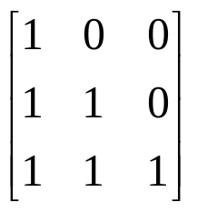
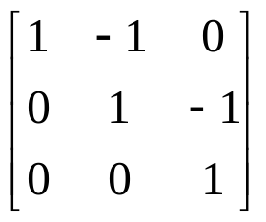
假設有一向量 w 對一組基底{v₁, v₂, v₃}的表示法為 [1 2 3]^{T}, 現在若另一組基底{u₁, u₂, u₃}且
u₁= v₁ , u₂= v₁ + v₂ , u₃ = v₁ + v₂ + v₃
請問 w 在新的基底{u₁, u₂, u₃}下的表示法為何?
Ans: M= 由 a=M^{T}b
b=(M^{T}) ⁻¹ a = [1 2 3]^{T} = [ -1 -1 3 ]

Slide 22

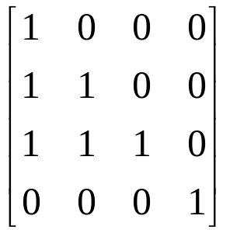
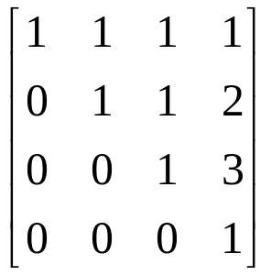
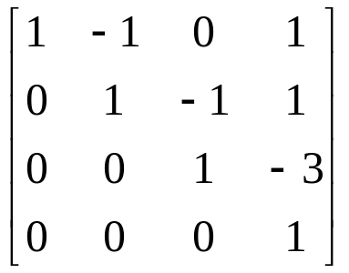
同上題, 若參考點不變 Q0=P0 , 則 M=
假設我們希望移動參考點到 [1 2 3 1]
Q0=P0 + v₁ + 2v₂ + 3v₃ 則 M^{T}=
T=(M^{T}) ⁻¹ =

Slide 23
所以 T 把一個點為 [1 2 3] , 在Frame下的表示法
為 p=[1 2 3 1] ^{T} 轉換到點 p’ = [0 0 0 1] ^{T}
假設原座標下 有一向量 v = [1 2 3 ] 表示為
a= [1 2 3 0]^{T}
轉換過去的新座標為 b = [-1 -1 3 0]^{T}
T=(M^{T}) ⁻¹ =

Slide 24

Every linear transformation is equivalent to a change in frames
Every affine transformation preserves lines
However, an affine transformation has only 12 degrees of freedom because 4 of the elements in the matrix are fixed and are a subset of all possible 4 x 4 linear transformations

Slide 25

When we work with representations, we work with n-tuples or arrays of scalars
Changes in frame are then defined by 4 x 4 matrices
In OpenGL, the base frame that we start with is the world frame
Eventually we represent entities in the camera frame by changing the world representation using the model-view matrix
Initially these frames are the same (M=I)

Slide 26

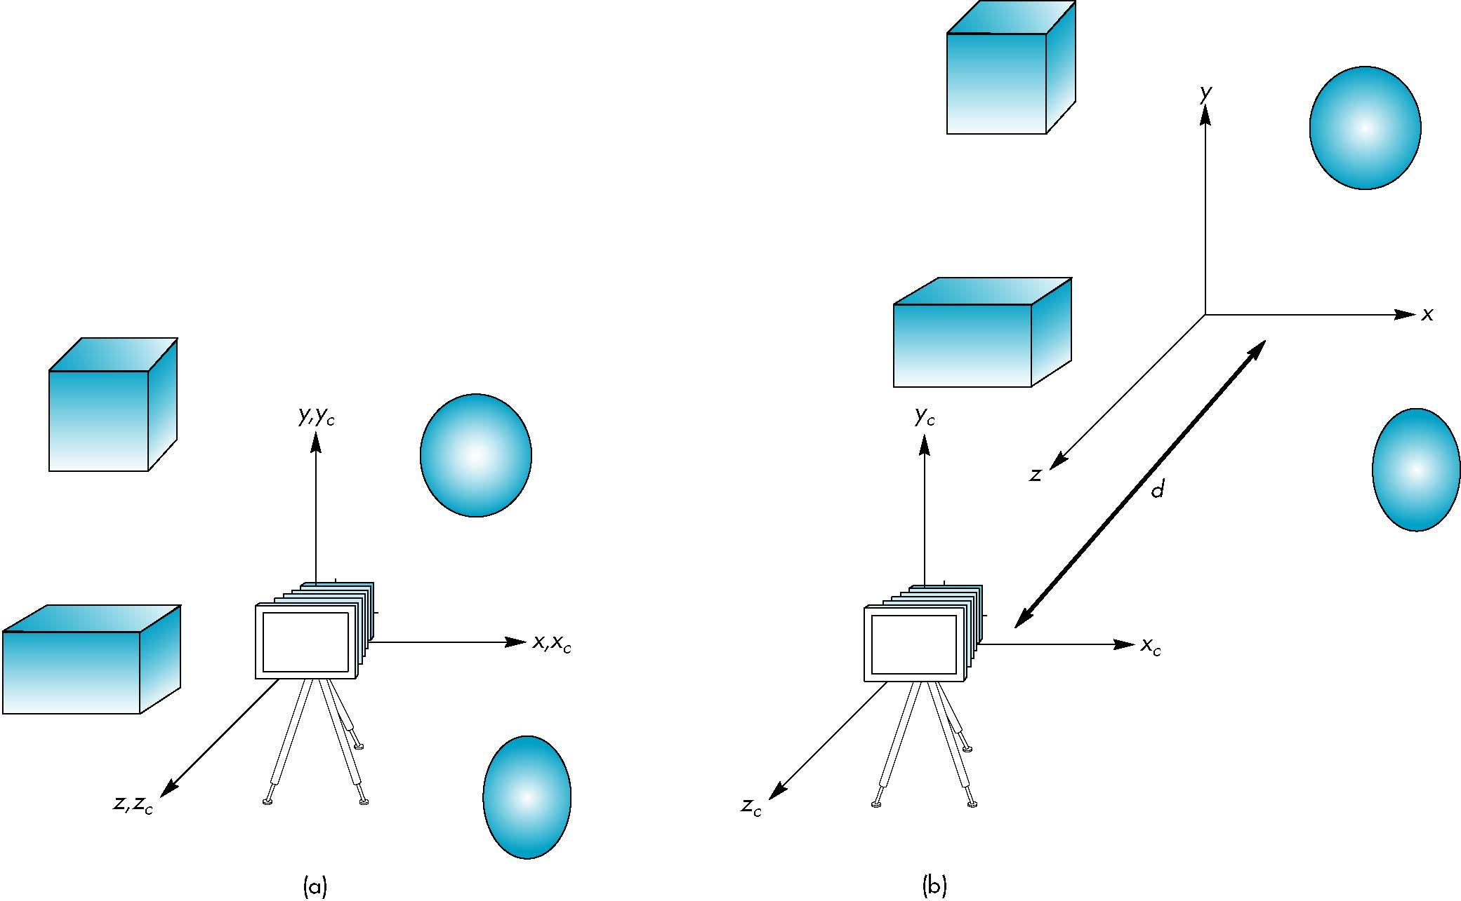
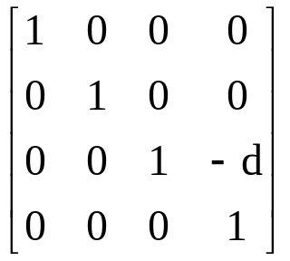
If objects are on both sides of z=0, we must move camera frame
M =

Slide 27

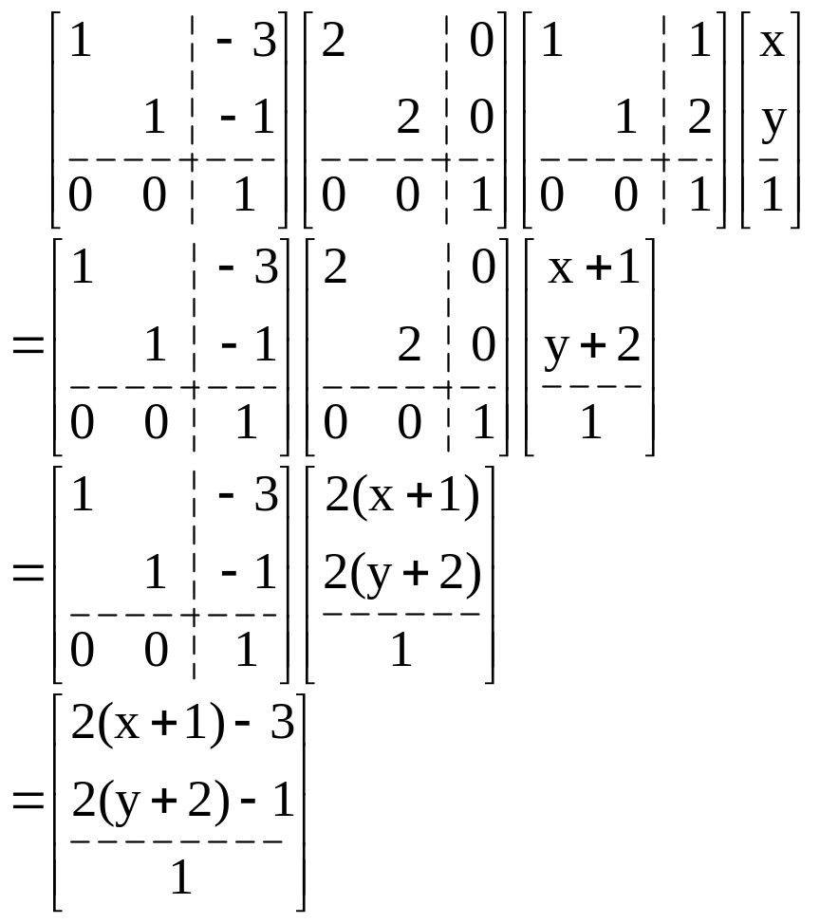
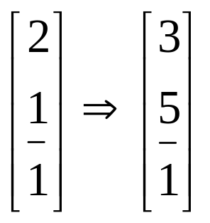
Translate(-3,-1)
Scale(2,2)
Translate(1,2)
Vertex(x,y)

Slide 28

Translate(-3,-1)
Scale(2,2)
Translate(1,2)
Vertex(x,y)

Slide 29

Translate(-3,-1)
Scale(2,2)
Translate(1,2)
Vertex(x,y)

Slide 30

Translate(-3,-1)
Scale(2,2)
Translate(1,2)
Vertex(x,y)
Note: translation in new scale

Slide 31

Translate(-3,-1)
Scale(2,2)
Translate(1,2)
Vertex(x,y)

Slide 32

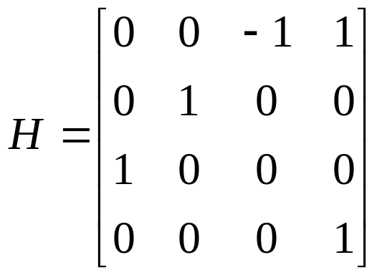
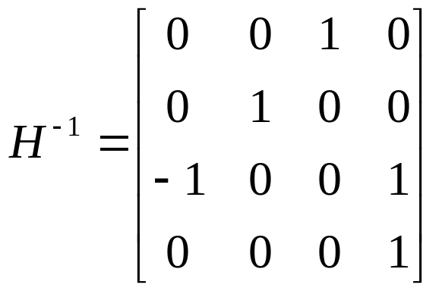
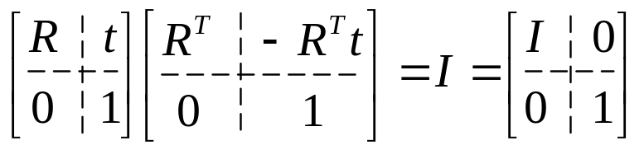
y
Transformation:
Rot(y,-90)+(1,0,0)
(0,1,0)
(1,1,0)
Transformation matrix:
x
(0,0,1)
y+z-1=0
z

Slide 33

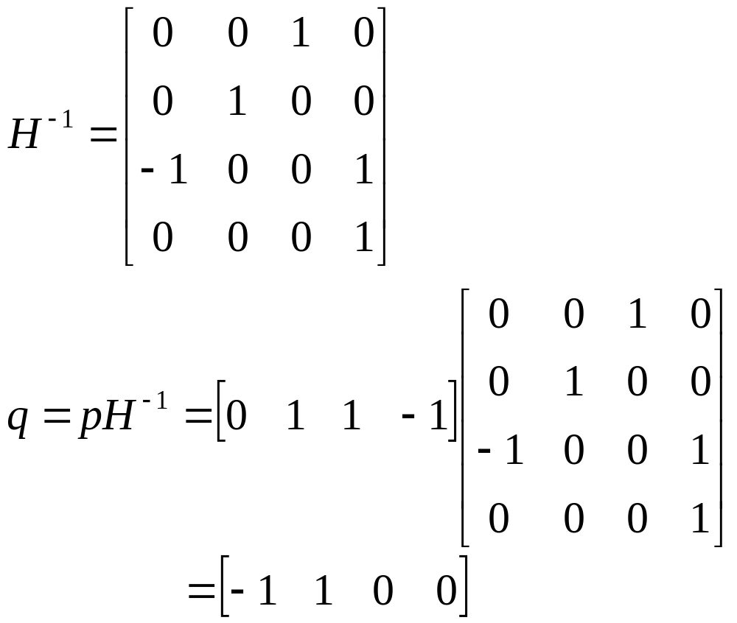
y
(1,1,0)
(1,1,1)
x
(0,0,0)
z
-x+y=0

